Slide 1
Vidya Pratishthan’s
Arts, Science & Commerce College, Baramati.
T.Y.B.B.A.(C.A.)
Software Testing
Presented By:
Asst. Prof. Shinde V.V.

Slide 2
Content
Introduction
What is Software Testing ?
Objectives of Testing
Goals of Testing
Testing Methodologies
Software Testing lifecycle – Phases
Testing Levels
Types of Performance Testing
Conclusion

Slide 3
Introduction
Testing is a process used to help identify the correctness, completeness and quality of developed computer software. With that in mind, testing can never completely establish the correctness of computer software.
There are many approaches to software testing from using alm tools to automated testing, but effective testing of complex products is essentially a process of investigation, not merely a matter of creating and following rote procedure.

Slide 4
What is Software Testing?
Executing software in a simulated or real environment, using inputs selected somehow.

Slide 5
Objectives of testing
Uncover as many as errors (or bugs) as possible in a given product.
Demonstrate a given software product matching its requirement specifications.
Validate the quality of a software testing using the minimum cost and efforts.
Generate high quality test cases, perform effective tests, and issue correct and helpful problem reports.

Slide 6
Error, Bug, Fault & Failure
Error : It is a human action that produces the incorrect result that produces a fault.
Bug : The presence of error at the time of execution of the software.
Fault : State of software caused by an error.
Failure : Deviation of the software from its expected result. It is an event.

Slide 7
Goals of Testing
Detect faults
Establish confidence in software
Evaluate properties of software
  Reliability
  Performance
  Memory Usage
  Security
  Usability

Slide 8
Testing Methodologies
White box testing
Black-box testing

Slide 9
White box testing
Knowledge of the internal program design and code required.
Tests are based on coverage of code statements, branches, paths, conditions.
Black box testing
No knowledge of internal program design or code required.
Tests are based on requirements and functionality.

Slide 10
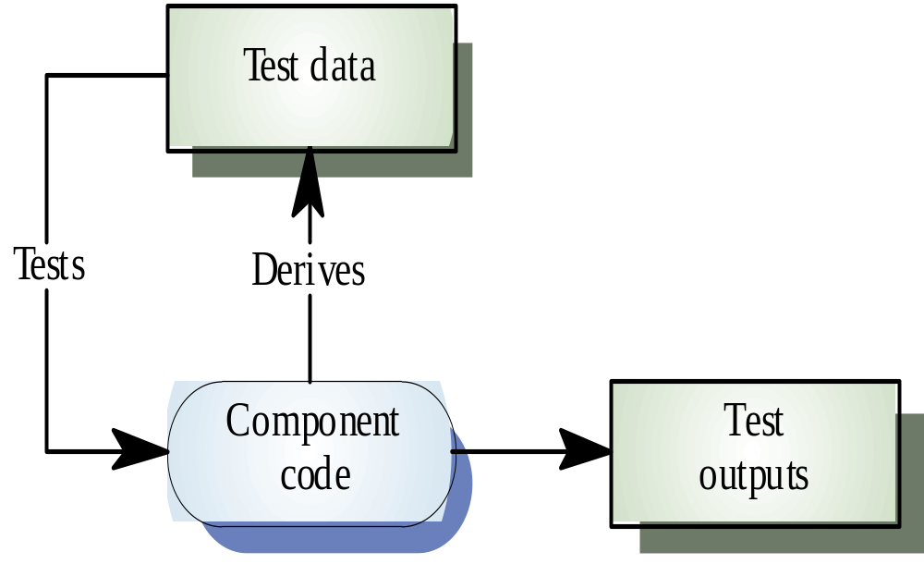
White-box Testing

Slide 11
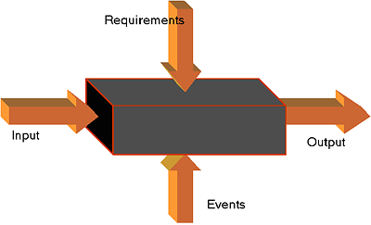
Black-box testing

Slide 12
Software Testing lifecycle - Phases
        Requirements study
        Test Case Design and Development
        Test Execution
        Test Closure
        Test Process Analysis

Slide 13
Requirements study
Testing Cycle starts with the study of client’s requirements.
Understanding of the requirements is very essential for testing the product.

Slide 14
Analysis & Planning
    Test objective and coverage
    Overall schedule
    Standards and Methodologies
    Resources required, including necessary training
    Roles and responsibilities of the team members
    Tools used

Slide 15
Test Case Design and Development
      Component Identification
      Test Specification Design
      Test Specification Review
Test Execution
      Code Review
      Test execution and evaluation
      Performance and simulation

Slide 16
Test Closure
      Test summary report
      Project De-brief
      Project Documentation
Test Process Analysis
Analysis done on the reports and improving the application’s performance by implementing new technology and additional features.

Slide 17
Testing Levels
Unit testing
Integration testing
System testing

Slide 18
Unit testing
Tests each module individually.
Follows a white box testing (Logic of the program).
Done by developers.

Slide 19
Integration testing
Once all the modules have been unit tested, integration testing is performed.
It is systematic testing.
Produce tests to identify errors associated with interfacing.
Types:
        Big Bang Integration testing
        Top Down Integration testing
        Bottom Up Integration testing
        Mixed Integration testing

Slide 20
System testing
The system as a whole is tested to uncover requirement errors.
Verifies that all system elements work properly and that overall system function and performance has been achieved.
Types:
Alpha Testing
Beta Testing
Acceptance Testing
Performance Testing

Slide 21
Alpha Testing
It is carried out by the test team within the developing organization .
Beta Testing
It is performed by a selected group of friendly customers.
Acceptance Testing
It is performed by the customer to determine whether to accept or reject the delivery of the system.
Performance Testing
It is carried out to check whether the system meets the nonfunctional requirements identified in the SRS document.

Slide 22
Types of Performance Testing
Stress Testing
Volume Testing
Configuration Testing
Compatibility Testing
Regression Testing
Recovery Testing
Maintenance Testing
Documentation Testing
Usability Testing

Slide 23
Conclusion
In order to be cost effective, the testing must be concentrated on areas where it will be most effective.
The testing should be planned such that when testing is stopped for whatever reason, the most effective testing in the time allotted has already been done.
The absence of an organizational testing policy may result in too much effort and money will be spent on testing, attempting to achieve a level of quality that is impossible or unnecessary.

Slide 24
Reference
www.google.com
www.wikipedia.com
www.studymafia.org

Slide 25
Thanks

